Slide 1
Two-Boundary vs Single-Boundary Model
KINARM interception task — reaction-time modelling
Recommendation: stay with the single-boundary model
16 participants · 40 participant × speed cells · 4,736 trials · hand only
Notes:
Bottom line up front: we built it, we tested it, it lost. This is a result, not a gap.

Slide 2
What we set out to do
A two-boundary model needs RT AND a per-trial two-way outcome. A Wald needs only RT.
Single-boundary (Wald)
Two-boundary (DDM)
Why the professors asked
Models reaction time only.
Parameters: drift v, boundary a, non-decision time t₀.
This is our current pipeline.
Models reaction time AND which of two responses was made, jointly.
Adds start point w — a bias the Wald cannot express.
The interception task has spatial structure the RT-only model ignores.
Fair question — so we tested it properly.
The blocker we hit first
HAND — works. SignedError_deg gives a per-trial two-way outcome (83.2% of trials present).
EYE — impossible. We audited all 38 columns across pooled_data.csv and all 16 master files. The only gaze columns are GazeSRT_ms and GazeWindow_ms, and GazeWindow_ms is a TIME, not a position.
Confirmed four ways: integer-valued every trial; does not scale with target speed (18.0 / 6.4 / 10.5 ms); near-zero correlation with every spatial variable; ±0.62 with the two RTs.
So a two-boundary model can only ever be fitted to the hand — which breaks the eye-vs-hand comparability we dropped LATER to protect.
Notes:
If they ask 'did you check under a different column name' — yes, exhaustively, all 38 columns in every file. GazeWindow_ms is the obvious candidate and it is a time, verified four independent ways.

Slide 3
Method — exactly what we used
Columns, coding, filters, and the four tests we ran
Columns
Coding: LEAD vs LAG
HandRT_ms — reaction time
SignedError_deg — the outcome. Equals wrap(HandDir_deg − TargetDir_deg), verified to 1e-12 on all 5,760 trials
Speed_deg_per_s, Participant, BlockType = 'I'
LEAD = positive signed error = hand ahead of the target
LAG = negative = hand behind the target
No left/right flip needed — both sides travel counter-clockwise (target displaces +17.8°/+35.3° left, +19.0°/+39.9° right)
Four tests
1
Readiness audit
2
Per-cell fit (MLE)
3
Hierarchical Bayes + LOO
4
Fairness control
Is the split balanced enough to identify the model?
Fit both models to the same 40 cells, compare likelihood
The rigorous version — PyMC, partial pooling
Simulate FROM the two-boundary model, re-run the test
Filters: interception blocks only, RT 150–800 ms, non-zero signed error → 5,760 trials in, 4,736 usable
Notes:
Be precise on terminology: it is LEAD vs LAG, a binary split at zero on the signed angular error. Not 'on-point'. There is a Direction column with Left/Right, but it labels which side the target starts on, not a choice the participant made, so it cannot serve as a DDM boundary.

Slide 4
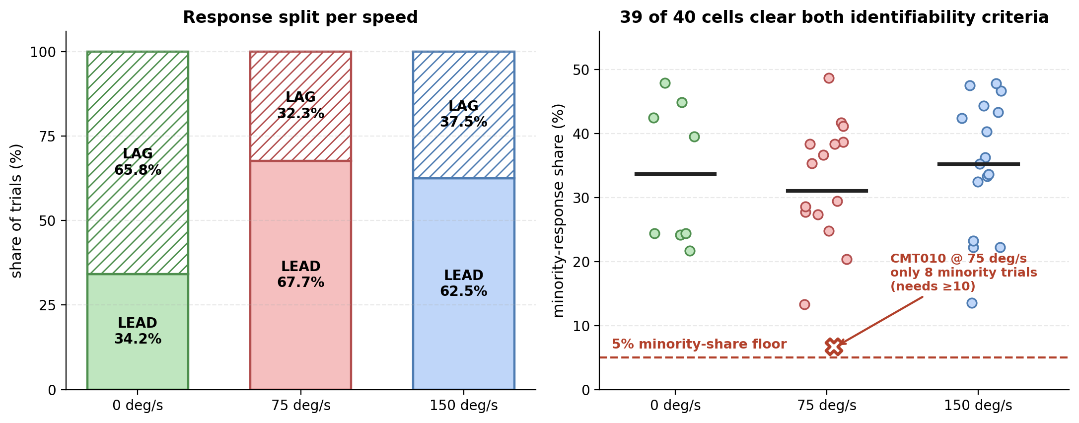
Step 1 — the data can support the model
Before fitting anything: is the lead/lag split balanced enough to identify the parameters?
Minority share 32–38% at every speed — six times above the 5% identifiability floor
39 of 40 cells clear both criteria (≥5% minority share AND ≥10 minority trials)
Note: 0 deg/s has only 8 cells, because CMT003–CMT010 have no direction data at that speed
Notes:
39 of 40 CELLS, not trials. A cell is one participant at one speed. The one that falls short, CMT010 at 75 deg/s, has a 6.7% minority share which clears the 5% bar but only 8 minority trials, below the 10-trial minimum. It is not excluded, it just leans on the group in the hierarchical fit.

Slide 5
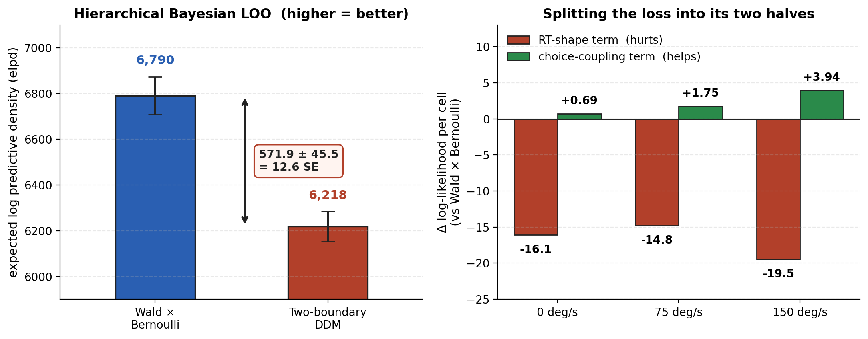
Step 2 — the result: the two-boundary model loses
Both models fitted to the same data with the same number of parameters, so likelihoods compare directly
Hierarchical Bayesian LOO: Wald × Bernoulli 6,790 vs two-boundary 6,218 — a gap of 571.9 ± 45.5, or 12.6 standard errors
Model weight for the two-boundary DDM: 0.0005. Per-cell MLE agrees — it wins in only 7 of 40 cells
But splitting the loss shows the decision structure is NOT the problem — the choice term is positive and grows with speed
Notes:
elpd is expected log predictive density — how well a model predicts data it has not seen. Higher is better. A difference of 12.6 standard errors is overwhelming; anything past about 4 is considered decisive. The model weight of 0.0005 means that if you had to bet on one model, you would put 0.05% on the two-boundary.

Slide 6
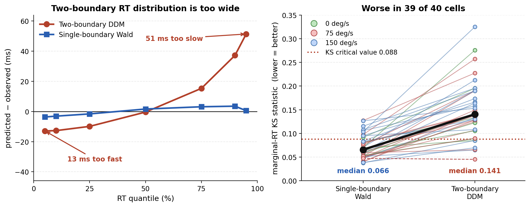
Step 3 — why it loses (this is the interesting part)
The two-boundary model gets the decision right and the reaction-time distribution wrong
Its RT distribution is 13 ms too fast at the 5th percentile and 51 ms too slow at the 95th — far too spread out
Goodness-of-fit: median KS 0.141 vs the Wald's 0.066, against a critical value of 0.088. Worse in 39 of 40 cells
We tried the standard fix (drift variability). The likelihood decreased monotonically — it made the fit worse, not better
Notes:
This is the slide to spend time on. The model is not failing because two boundaries are the wrong idea — it is failing because a diffusion that produces a 35/65 split necessarily produces reaction times far more variable than we observe. Adding drift variability, the standard fix, made it strictly worse.

Slide 7
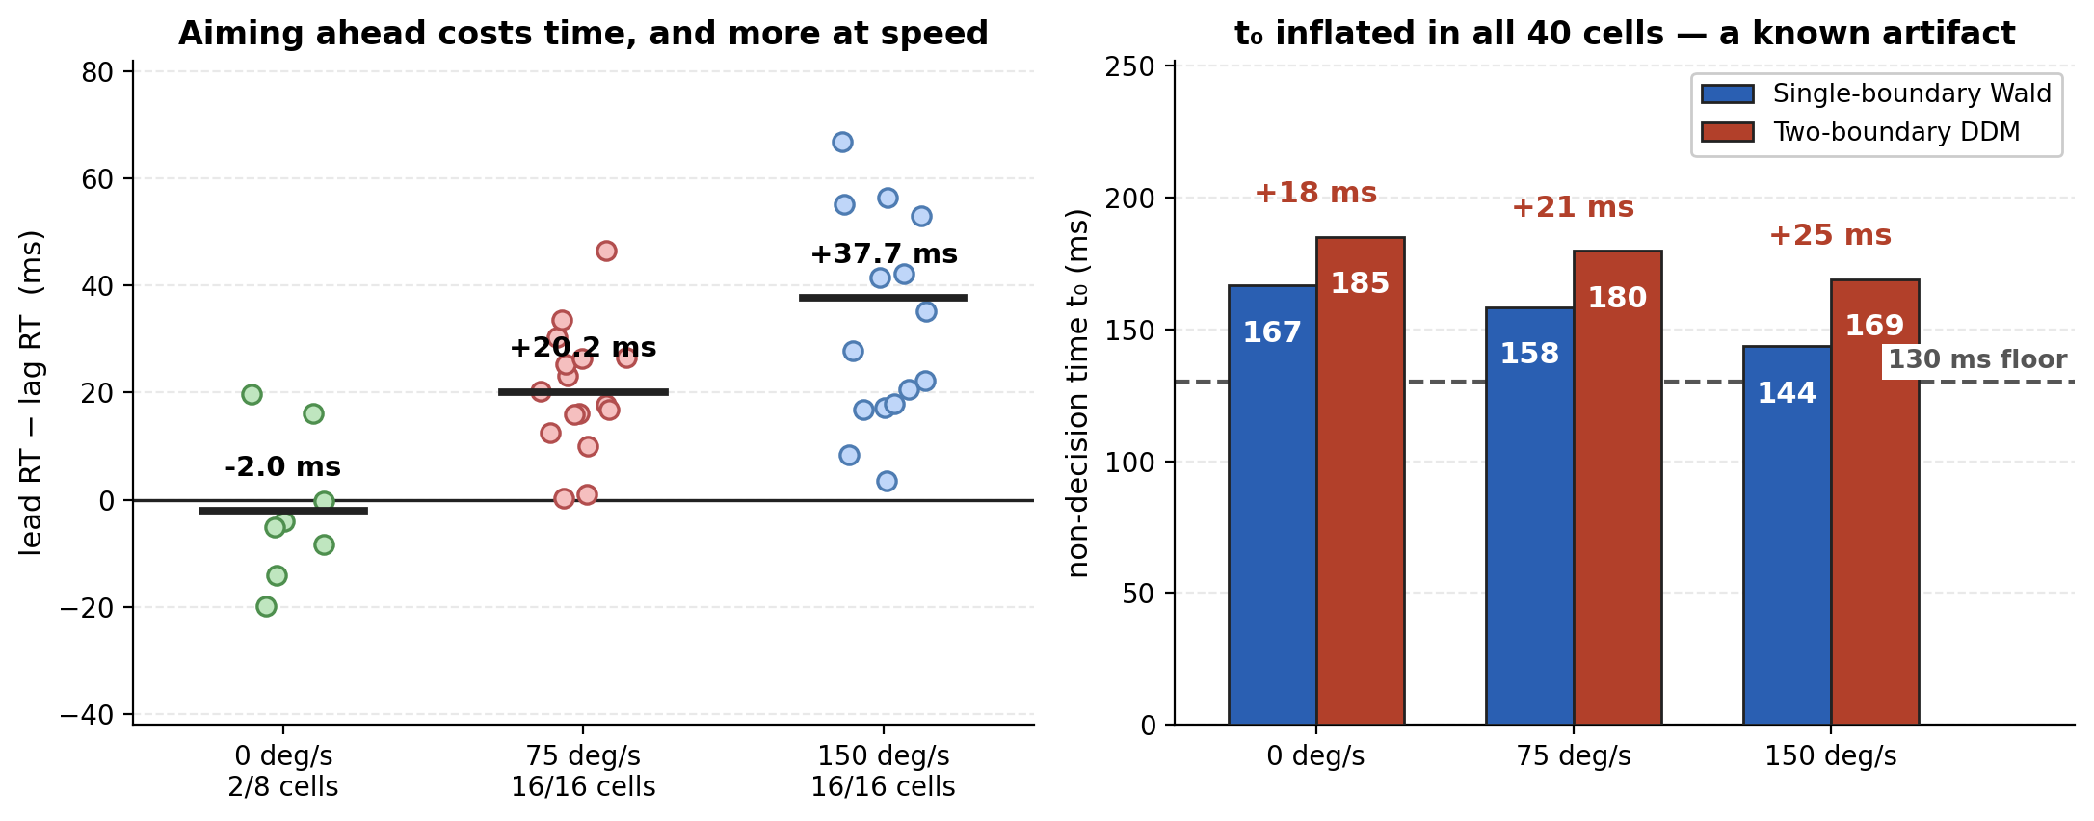
Step 4 — what survives, and the t₀ warning
One solid model-free finding, and one number not to report
KEEPER: lead responses are slower than lag — +20.2 ms at 75 deg/s and +37.7 ms at 150, in 16 of 16 cells both times, and nothing at 0 deg/s
WARNING: the two-boundary t₀ is inflated by ~22 ms in all 40 cells. Recovery simulation shows +30 ms bias when the truth is single-boundary
Our published single-boundary t₀ values stand. The start point w = 0.403 is also suspect for the same reason
Notes:
The lead/lag effect is the keeper — it needs no model at all and it is beautifully consistent. On t0: we checked whether the two-boundary number might be the better estimate. It is not. Simulating from a Wald with a known t0 of 170 ms, the two-boundary model recovers 200.5 ms — a +30 ms artifact, almost exactly the inflation we see in the real data.

Slide 8
Recommendation
Stay single-boundary — and report the two-boundary test as a result
What we report
The one-line version
• Single-boundary Wald stays primary, for hand and eye
• The two-boundary test as a finding, not an omission
• The lead/lag RT effect as a model-free result
• The Wald's honest limits: weak t₀ identifiability, 130 ms floor binding in 14 of 40 hand cells
We did not decline to fit a two-boundary model. We fitted it, validated it four ways, extended it, and it lost by 12.6 standard errors — for a specific, diagnosable reason we can explain.
What would change our minds
A gaze spatial variable — saccade landing position out of the raw KINARM traces. Restores eye/hand symmetry and lets us run the same test on the eye.
A genuine discrete choice in the task — two targets, a cued alternative, anything the participant actually chose between. None exists in the current data.
A circular diffusion model (Smith 2016; Ratcliff 2018) — the principled model for a continuous spatial response. Caveat: it may inherit the same RT-precision problem.
Recovering the missing 0 deg/s data — CMT003–CMT010 have no direction data there, costing us 8 of 16 cells at the cleanest baseline condition.
Notes:
Lead with: this is a result. Then the four things that would reopen it. The gaze variable is the one to push on because it also fixes the comparability problem.

Slide 9
Numbers to remember
12.6 SE
7 / 40
39 / 40
how decisively the two-boundary model lost (LOO)
cells where it beat the simpler model
cells with enough data to fit it — data was never the problem
0.141 vs 0.066
+22 ms
+37.7 ms
its RT goodness-of-fit vs the Wald (0.088 = fail)
t₀ inflation — an artifact, not a correction
lead-vs-lag RT cost at 150 deg/s, 16/16 cells
Notes:
Close on the last one — the lead/lag effect is ours to keep regardless of which model wins.

